Slide 1
Virtualization in Cloud Computing
Unit III

Slide 2
Virtual Clustering
Virtual Cluster is an collection of Virtual Machines (VMs) are networked together to function as a single logical computing resource, despite being hosted on diverse physical nodes.
Physical cluster consists of interconnected standalone servers
Virtual cluster is dynamic—it can span across multiple physical hosts or be consolidated within one

Slide 3
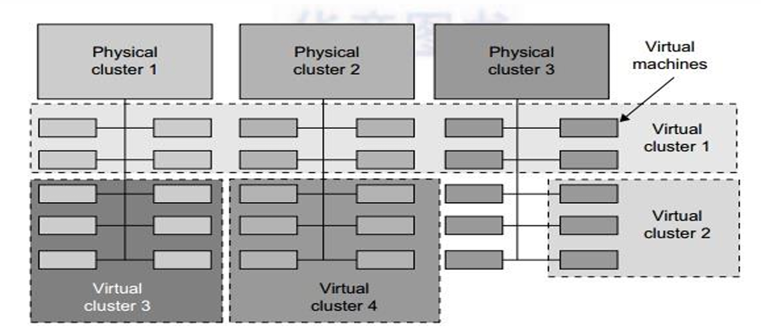
Virtual Clustering

Slide 4
Core Characteristics of a Virtual Cluster
Node Abstraction : Each node in the cluster is a VM allowing cluster to run different Operating Systems on the same physical infrastructure.
Dynamic Connectivity: "interconnect" between nodes is a Virtual LAN (VLAN) or a virtual switch meaning the network topology can be reconfigured through software without using single cable
Resource Isolation: When multiple virtual clusters share the same physical server, the VMM (Hypervisor) ensures that a memory leak or CPU spike in one cluster does not affect another cluster.
Elasticity: Nodes can be added to or removed from the cluster instantly (Live Provisioning) to handle fluctuating application demands.
Shared Storage: For a cluster to be effective (especially for failover), all VMs must usually point to a common storage backend, such as a Storage Area Network (SAN) or Network Attached Storage (NAS).

Slide 5
Deployment Models
Based on how clusters interact with the physical hardware:
Single-Host Cluster: All virtual nodes reside on one powerful physical server, mostly used for testing or small-scale development.
Multi-Host (Distributed) Cluster: Virtual nodes are spread across several physical servers, providing High Availability (HA). If one physical server fails, only a fraction of the virtual cluster's nodes go down, and they can often be restarted on a different host.

Slide 6
Virtual Clustering in Enterprise Context
Load Balancing: Virtual clusters are often used behind a load balancer to handle web traffic. As traffic increases, the system automatically adds more VM "clones" to the cluster
High Availability (HA): If a physical host fails, the virtual cluster detects the loss of those VMs and automatically restarts them on healthy physical hosts, maintaining the "quorum" of the cluster.
Cost Efficiency: By "packing" virtual cluster nodes onto fewer physical machines, enterprises achieve higher hardware utilization rates.
Distributed File Systems: These allow all VMs in the cluster to access the same data set simultaneously, ensuring that no matter which VM processes the request, the data is consistent.

Slide 7
Pitfalls of Virtualization
Capacity and costs fail to meet expectations.
Application fails to run (or fails to run adequately) in a virtual environment.
Licensing cost increase and some software is not supported.
Managers, executives, users and other “server huggers” resist virtualization.
Virtualization exposes unforeseen security risks.

Slide 8
What are Applications of virtual clustering on enterprise level?
A scenario based case study on virtual cluster

Slide 9
What is Virtualization in Grid Computing?
Grid computing—which involves connecting geographically distributed, heterogeneous, and often autonomous computing resources to act as a single, massive virtual computer.
Virtualization acts as the critical glue that makes this complex system usable and efficient.
Without virtualization, a grid is essentially a loose collection of different hardware, operating systems, and network configurations that are difficult to manage together.
Instead of an application having to be "tuned" for a specific machine in a specific lab, it runs within a standardized Virtual Workspace or Virtual Machine (VM).
In a grid, this means a user can submit a job, and the grid middleware (the management software) can instantiate a standardized virtual environment on whatever remote physical resource is available, regardless of that machine’s native configuration.

Slide 10
How Virtualization Powers the Grid?
Encapsulation of Environments: A grid user can package their entire software stack (the OS, libraries, and application) into a single virtual image. This ensures that the application runs exactly the same way on a server in one country as it does on one in another.
Resource Pooling & Abstraction: Virtualization allows grid providers to pool heterogeneous physical resources (servers, storage, and networking) and present them as a uniform set of logical, virtual resources.
Dynamic Provisioning: Because virtual machines are essentially files, they can be moved, or shut down dynamically. If a grid node is overloaded, the system can migrate a running VM to another, less-busy node in the grid with minimal disruption (Live Migration).
Isolation & Security: In a grid, you are often running code from many different organizations on shared hardware. Virtualization ensures that if one VM crashes or is compromised, it does not affect other VMs or the host machine itself.

Slide 11
Key Benefits
Benefit | How it helps in Grid Computing
Portability | Allows applications to move across administrative domains without re-installation.
Heterogeneity | Masks differences between hardware types, making a diverse grid appear homogeneous to the user.
Simplified Management | Admins don't need to configure every node manually; they just need to ensure the hypervisor is running.
Fault Tolerance | If a physical node fails, VMs can be automatically restarted on another node using snapshots.

Slide 12
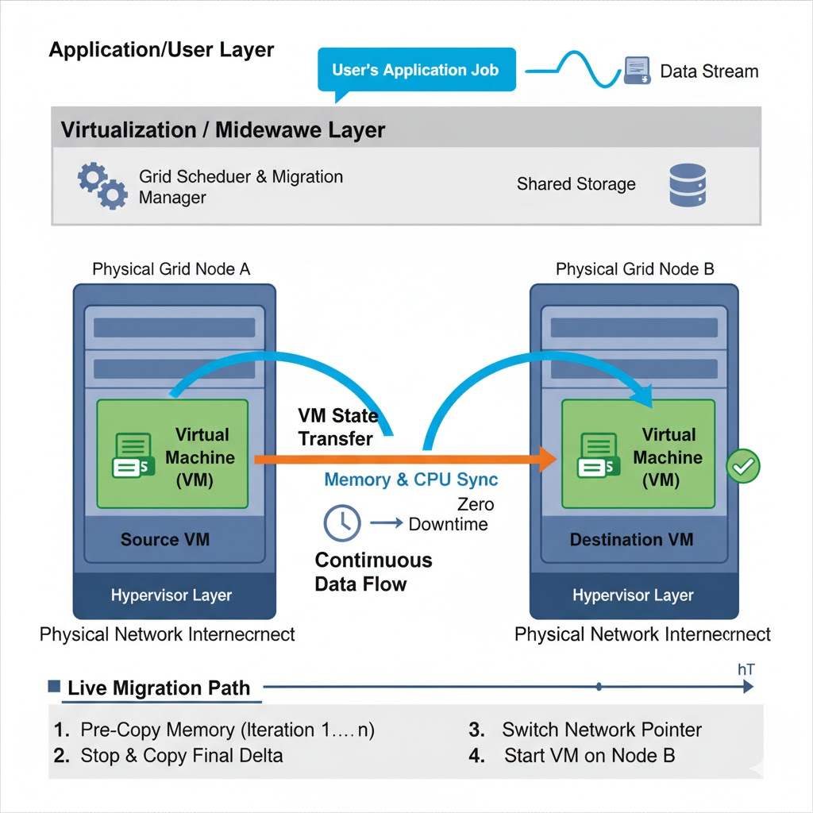
"Live Migration" process:
In a grid virtualization environment, the architecture is typically organized into three primary layers, acting as a bridge between the physical world and the user's request.
The Physical Grid Layer (The Base): This represents the heterogeneous hardware—servers, clusters, and storage systems—scattered across different locations. Each physical machine runs a Hypervisor (such as Xen, KVM, or VMware).
The Virtualization/Middleware Layer (The Bridge):
Virtual Workspace Service: This service manages the lifecycle of the virtual machines. It takes a "Virtual Appliance" (a pre-configured image containing the OS and application) and deploys it onto an available physical node.
Grid Scheduler: The scheduler communicates with the virtualization layer to identify where resources are available. It doesn't just look for a free computer; it looks for a free virtual container that meets the specific software requirements of the job.

Slide 13
"Live Migration" process:
The Application/User Layer (The Interface):
The user submits a job to the grid portal. Crucially, the user does not need to know the location of the hardware. They interact with a Virtual Workspace. From the application's perspective, the environment is identical regardless of which physical server in the global grid is actually processing the data.

Slide 14
Workflow of Virtualization in Grid:
When a user submits a task to the grid, the following sequence occurs:
Encapsulation: The user's job is packaged into a virtual machine image file.
Placement: The Grid Middleware selects an optimal physical node based on availability and proximity.
Instantiation: The selected node downloads or mounts the image and launches it via the Hypervisor.
Isolation: The job runs in its own private sandbox. Even if the underlying server is running jobs for ten different users, the hypervisor ensures each grid job remains secure and receives its allocated portion of the CPU and Memory cycles.

Slide 15
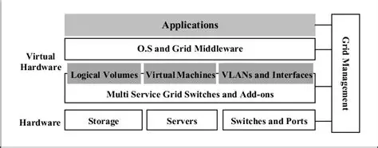
Layered Abstraction of virtualization in Grid:
The Hardware Layer:
At the bottom, you have the actual physical infrastructure. In a grid, these are often geographically dispersed: storage, server, Switches and ports.

Slide 16
Layered Abstraction of virtualization in Grid:
The Multi-Service Grid Layer : This acts as the interface to the hardware. It aggregate the raw physical components into a usable format, preparing them to be carved up into virtual pieces.
The Virtual Hardware Layer: By using a hypervisor or similar technology, the grid creates a Virtual Hardware environment that masks the underlying physical complexity:
Logical Volumes: Instead of worrying about specific physical disks, the grid creates virtualized storage pools.
Virtual Machines (VMs): These are the containers where actual user applications run, completely insulated from the physical server specs.
VLANs and Interfaces: Virtual networking allows the grid to maintain secure, high-speed communication channels between nodes regardless of the physical wiring.

Slide 17
Layered Abstraction of virtualization in Grid:
The Software Layers:
O.S and Grid Middleware: This is the brain of the operation. The middleware manages the "Grid" aspect—scheduling tasks, tracking resource availability, and ensuring security policies are followed across the network.
Applications: These are the end-user tasks. Because of the virtualization layers below them, these applications don't need to be "grid-aware"; they run as if they are on a standard machine.
Grid Management: It is responsible for
Monitoring: Keeping an eye on the health of hardware and virtual components.
Provisioning: Creating, moving, or destroying Virtual Machines on demand.
Orchestration: Ensuring the right applications get the right resources at the right time.

Slide 18
Grid vs. Cloud Virtualization
Feature | Virtualization in Grid | Virtualization in Cloud
Primary Goal | Interoperability: Making different systems work together as one. | Efficiency: Maximizing the use of local data center hardware for many users.
Resource View | Aggregative: Joining many small pieces into one giant supercomputer. | Distributive: Dividing one giant resource into many small, rented parts.
Management | Decentralized; often managed by "Grid Middleware" across different orgs. | Centralized; managed by a single Cloud Provider (e.g., AWS, Azure).
Tenancy | Usually Single-user focused for high-performance tasks. | Multi-tenant: Designed for thousands of users to share one server securely.
Workflow | Job-based: A VM is created to run a specific task and then deleted. | Service-based: A VM is created as a long-running server or database.

